Slide 1
Santander Customer Transaction Prediction
Binary Problem
Maria Clara Mendes da Silva

Slide 2
Content
Problem Statement
Dataset
Methodology
Results
Conclusion
References

Slide 3

Problem Statement
Santander’s purpose is to help people and businesses prosper. ¹
Is a customer satisfied?
Machine Learning Algorithms
Help to solve most common challenge
Binary Classification Problems
Will a customer buy this product?
Can a customer pay this loan?
Which customer will make a specific transaction in the future, irrespective of the amount of money transacted.
...
¹ www.santander.com

Slide 4
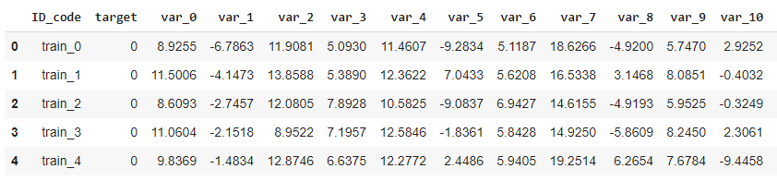
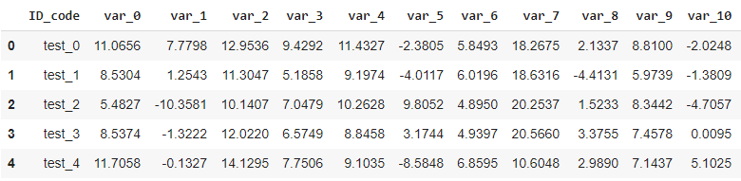
Dataset
Regression models to predict which customers will make a specific transaction in the future.
The Santander customer transaction sample for:
Train dataset: (200000, 202)
Test dataset: (200000, 201)

Slide 5
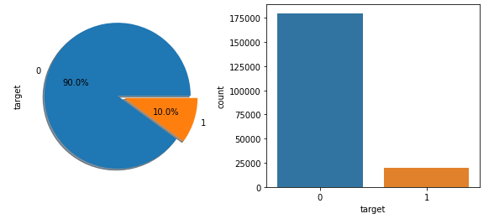
Methodology
1. Importing dataset
Train and Test
2. Loading Libraries
3. Exploratory Data Analysis
4. Attributes Distribution and Trends
5. Missing Value Analysis and Outliers
6. Feature Selection
Unbalaced data!
7. Feature Engineering
8. Modeling
9. Results

Slide 6
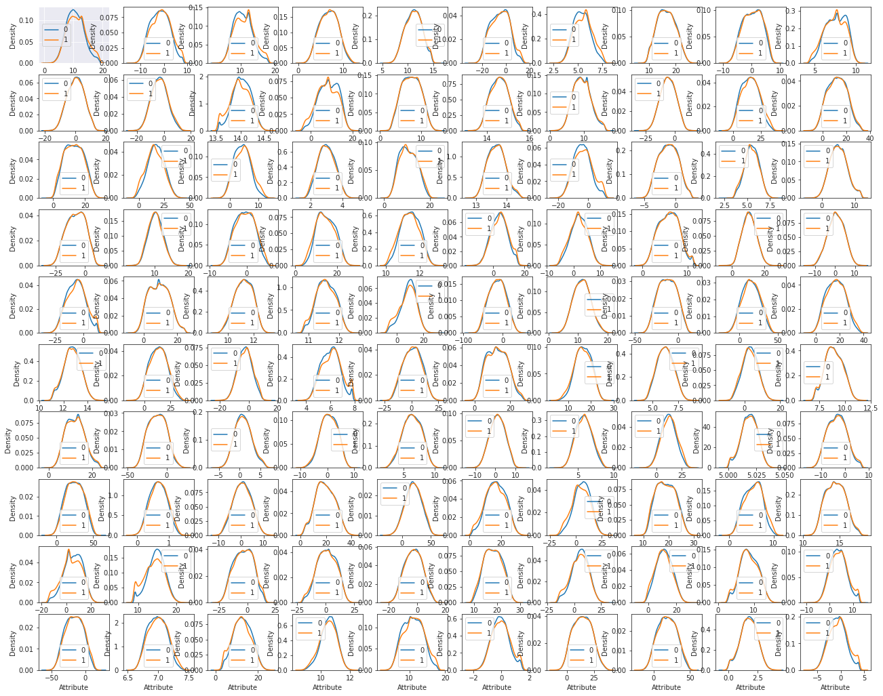
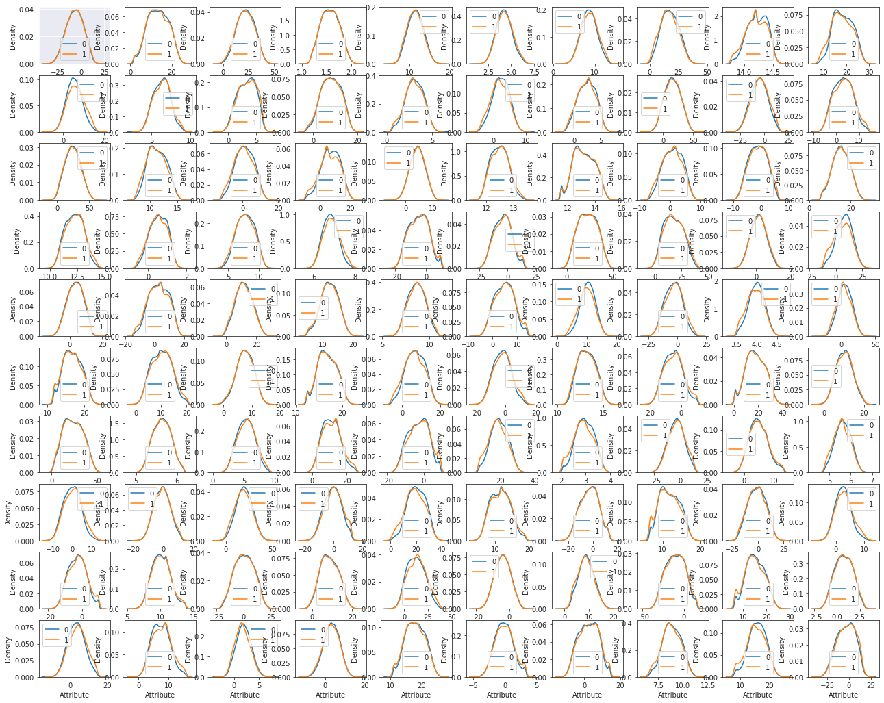
3. Exploratory Data Analysis
6.1. Train Attributes

Slide 7
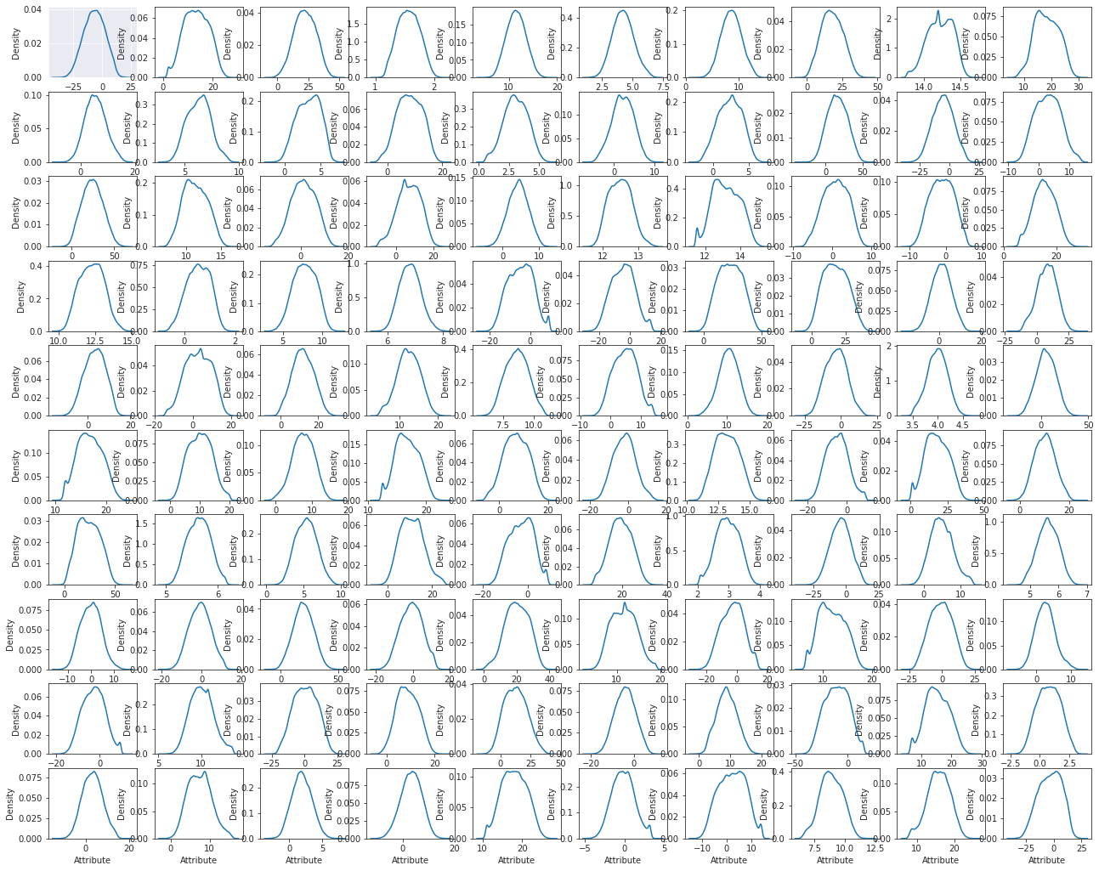
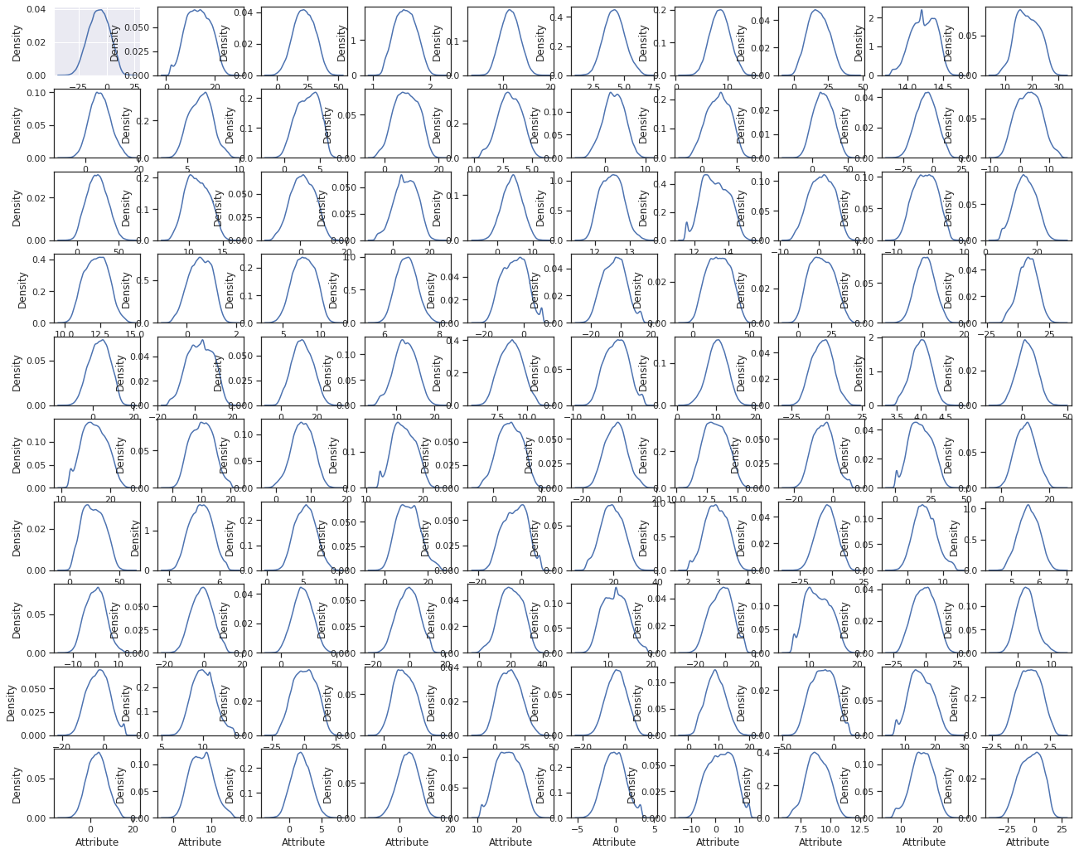
3. Exploratory Data Analysis
6.2. Test Attributes

Slide 8
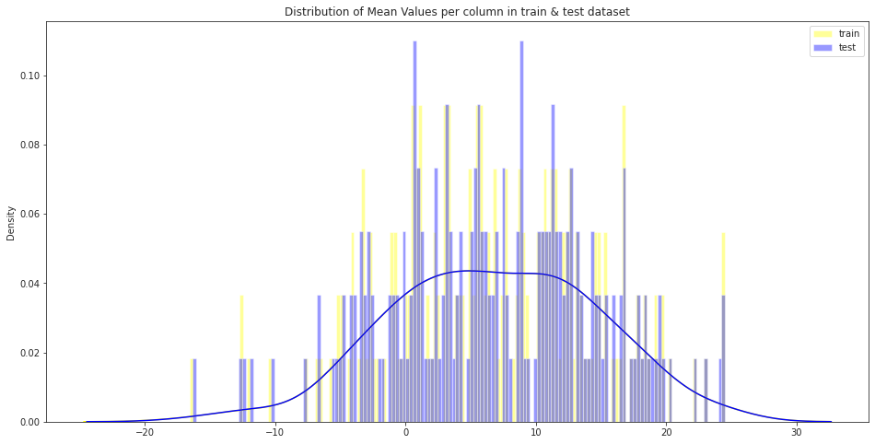
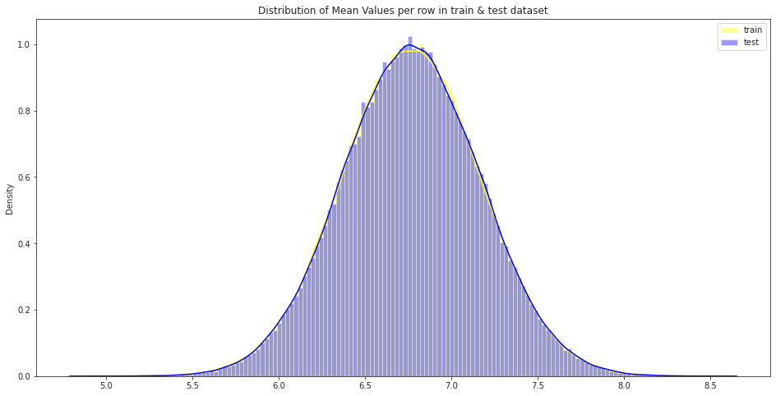
4. Attributes Distribution and Trends
Distribution of Mean Values per column and row in train and test dataset

Slide 9
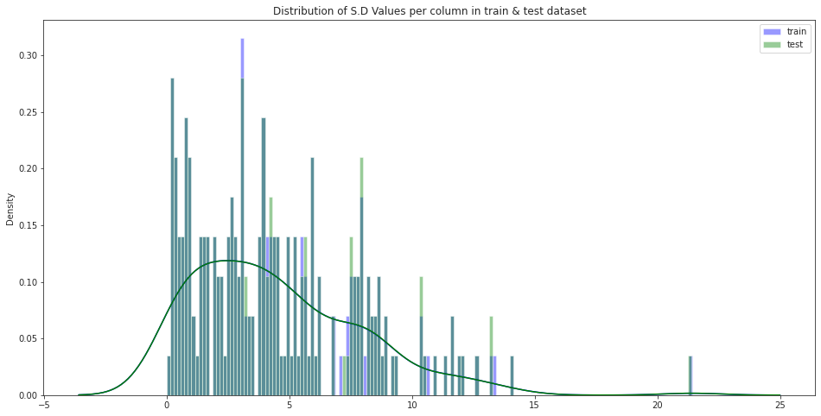
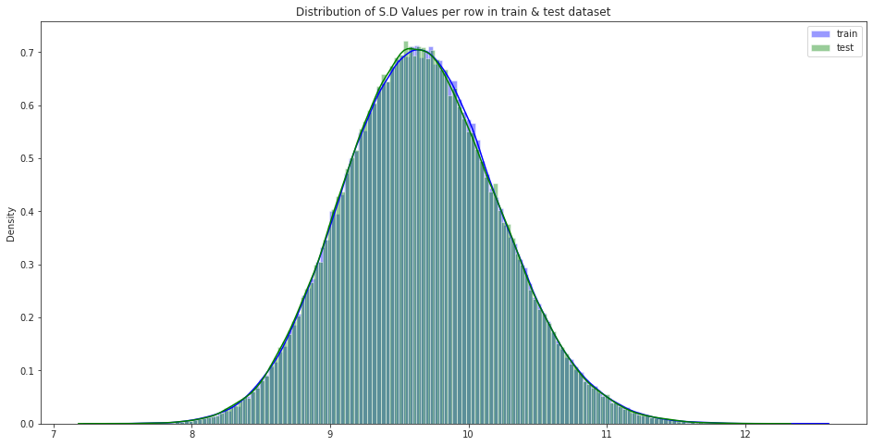
4. Attributes Distribution and Trends
Distribution of S.D Values per column and row in train and test dataset

Slide 10
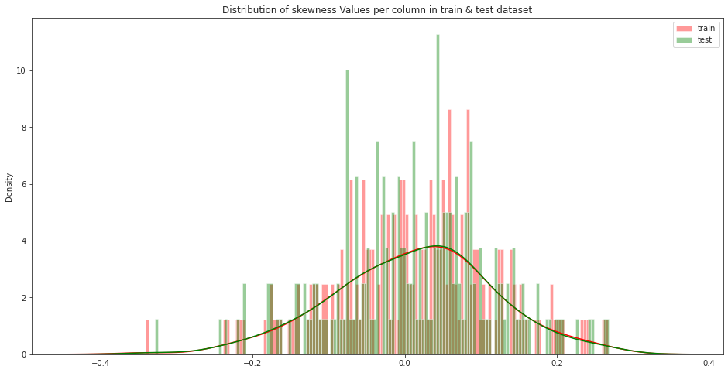
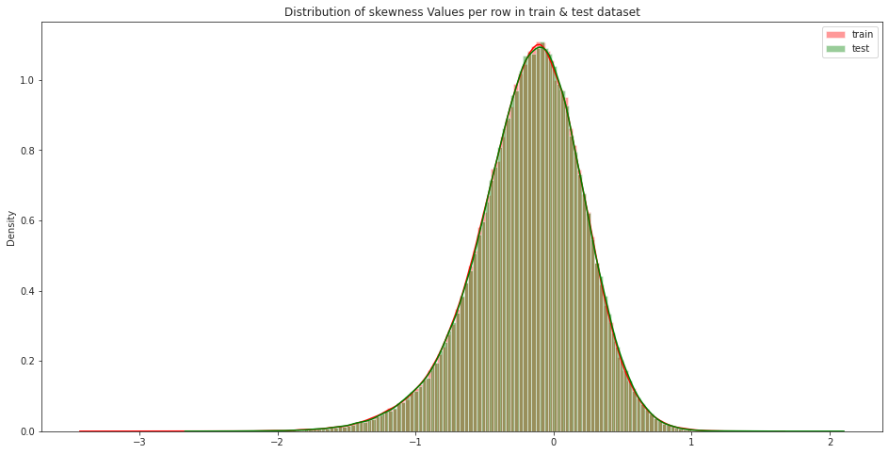
4. Attributes Distribution and Trends
Distribution of skewness Values per column and row in train and test dataset

Slide 11
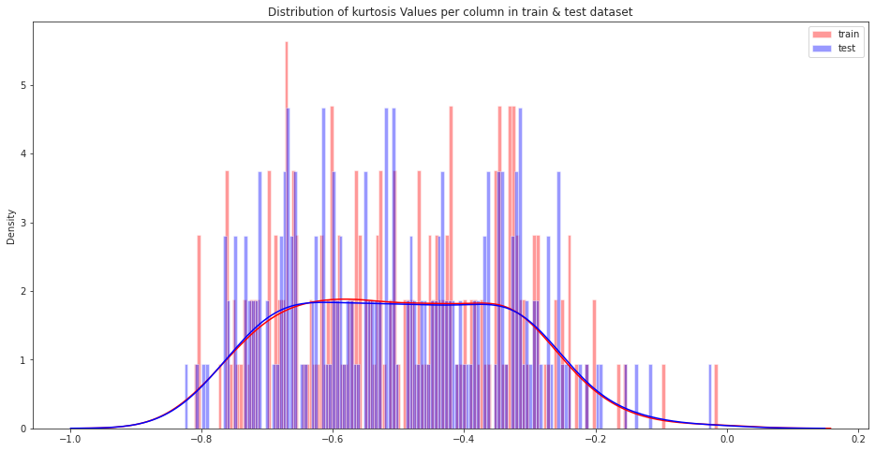
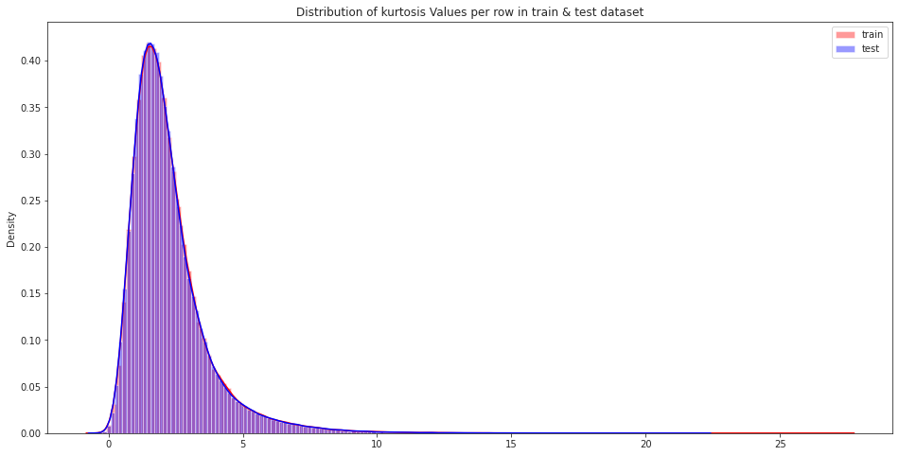
4. Attributes Distribution and Trends
Distribution of kurtosis Values per column and row in train and test dataset

Slide 12
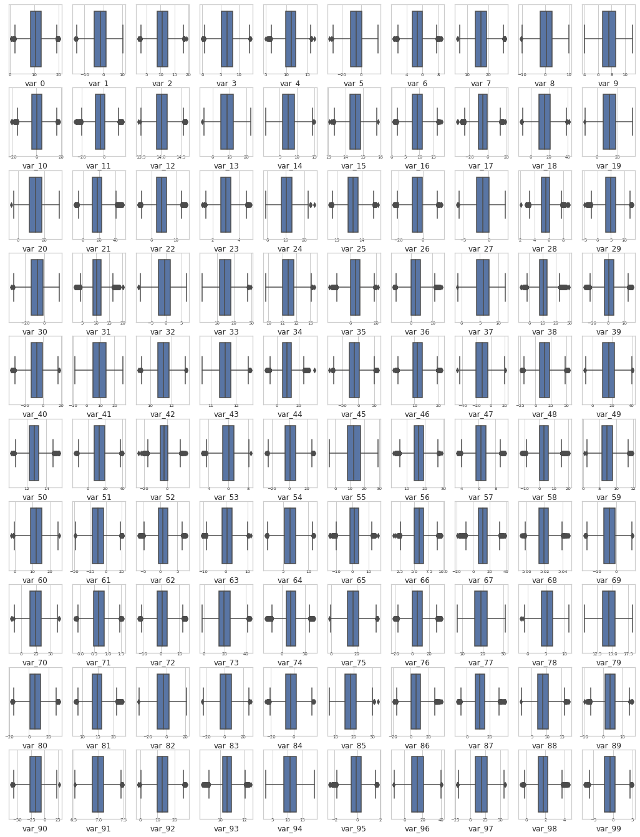
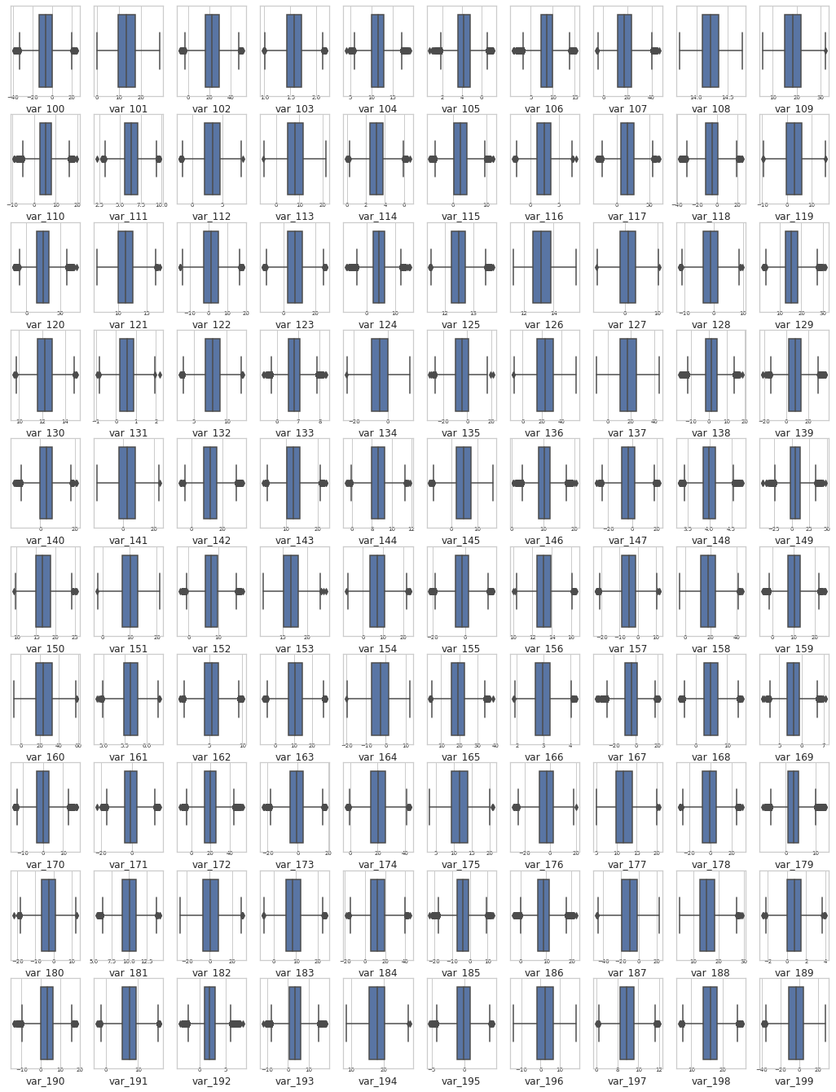

5. Missing Value Analysis and Outliers
Outliers Train Data
Missing Value Analysis

Slide 13
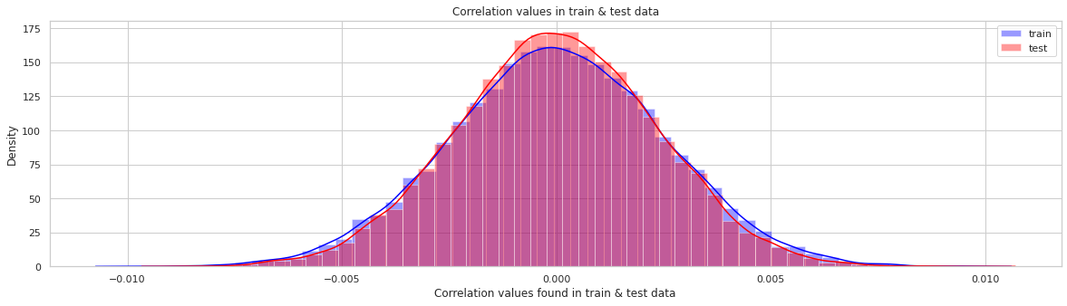
6. Feature Selection
Correlation Matrix
7. Feature Engineering
Training and Testing Data
Split the Train Data

Slide 14
8. Modeling
Model Selection
The dependent variable categories:
1. Nominal
2. Ordinal
3. Interval
4. Ratio
Classification
Regression
Binning
Classification

Slide 15
8. Modeling
Regression
Handling of Imbalance Data
Logistic Regression Algorithm
Light GBM
Synthetic Minority Oversampling Technique (SMOTE)
Logistic Regression Algorithm
Results
Results

Slide 16
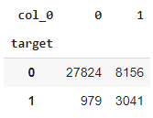
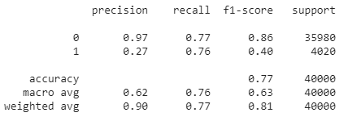
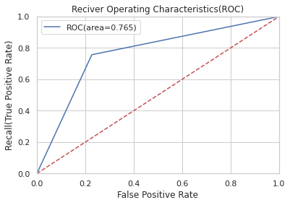
Logistic Regression Algorithm
Training Data
Fitting the Model
Accuracy of the Model
Cross Validation Prediction
0.77263125
0.771625
Classification Report
ROC Curve
(Receiver Operating Caracteristic Curve)
Confusion Matrix
Accuracy of the model is not the best metric to use when evaluating the imbalanced datasets as it may be misleading. So, next step is to change the performance metric.

Slide 17
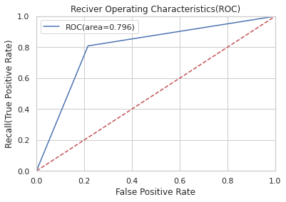
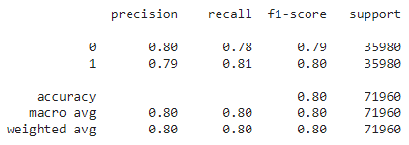
Synthetic Minority Oversampling Technique (SMOTE)
Synthetic Minority Oversampling Technique (SMOTE): SMOTE uses a nearest neighbor’s algorithm to generate new and synthetic data to use for training the model. In order to balance imbalanced data we are going to use SMOTE sampling method.
Bulding Logistic Regression on Synthetic Data Points
ROC Curve:
Fitting the smote model:
Accuracy of the smote model: 0.791522862940854
Cross Validation Prediction for Smote: 0.7962201222901613
Classification Report:
We can observed that smote model
is performing well on imbalance data compare to baseline logistic regression.

Slide 18
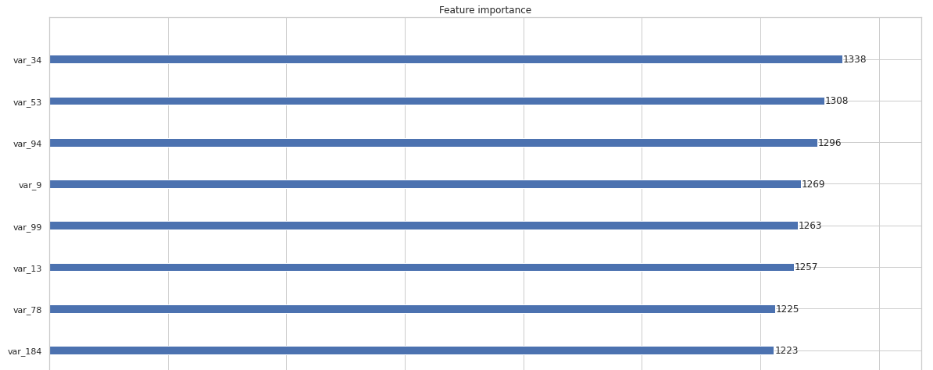
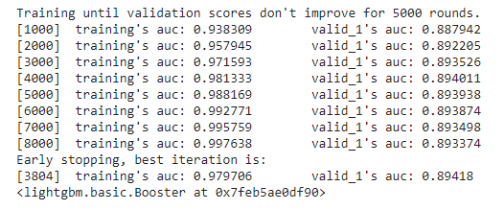
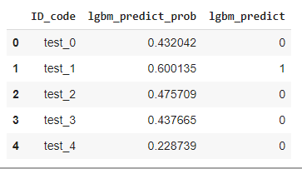
Light GBM
Training Data
Important Features
Validation Data
Selecting best hyperparameters by tuning of different parameters:
Training lgbm model:
LGBM model performance on test data:

Slide 19
Conclusion
The results obtained for both algorithms, mainly, by the scores and area under the ROC curve for all the models for an imbalanced data is possible to conclude that Logistic Regression model has not performed well on imbalanced data.
After using resampling techniques, as SMOTE, results for logistic regression turned out to be better. Finally, Light GBM model has performed well on imbalanced data, even better than Logistic regression on balanced data.
So, the best choice for identifying which costumer will make a specific transaction is LightGBM.

Slide 20
References
Santander Customer Transaction Prediction. Kaggle, 2019. Disponível em: <https://www.kaggle.com/c/santander-customer-transaction-prediction/data>. Acesso em: 08, abril de 2021.
Santander customer transaction prediction a simple machine learning solution. Medium, 2019. Disponível em: <https://medium.com/@aganirbanghosh007/santander-customer-transaction-prediction-a-simple-machine-learning-solution-771613633843>. Acesso em: 08, abril de 2021.
Raimondi, Frederico. Santander_Customer_Transaction_Prediction. Github, 2019. Disponível em:https://federicoraimondi.github.io/myProjects/Santander_Customer_Transaction_Prediction/> Acesso em: 09, abril de 2021.
Vaz, Arthur. Como lidar com dados desbalanceados em problemas de classificação. Medium, 2019. Disponível em: https://medium.com/data-hackers/como-lidar-com-dados-desbalanceados-em-problemas-de-classifica%C3%A7%C3%A3o-17c4d4357ef9 Acesso em: 09, abril de 2021.
5 smote techniques for oversampling your imbalance data. Towards Data Science, 2019. Disponível em: <https://towardsdatascience.com/5-smote-techniques-for-oversampling-your-imbalance-data-b8155bdbe2b5> Acesso em: 09, abril de 2021.
Mandot, Pushkar. what-is-lightgbm-how-to-implement-it-how-to-fine-tune-the-parameters. Medium, 2017. Disponível em:<https://medium.com/@pushkarmandot/https-medium-com-pushkarmandot-what-is-lightgbm-how-to-implement-it-how-to-fine-tune-the-parameters-60347819b7fc> Acesso em: 10, abril de 2021.
Santander Customer Transaction Prediction code. Kaggle, 2019. Disponível em: https://www.kaggle.com/c/santander-customer-transaction-prediction/code Acesso em: 10, abril de 20121.

